Slide 1



Operators and Expressions
Performing Simple Calculations with C#
SoftUni Team
int bit = (n & (1 << p)) >> p;
n = n & (~(1<<p)) | (bit<<p);
Technical Trainers
Software University
http://softuni.bg

Slide 2
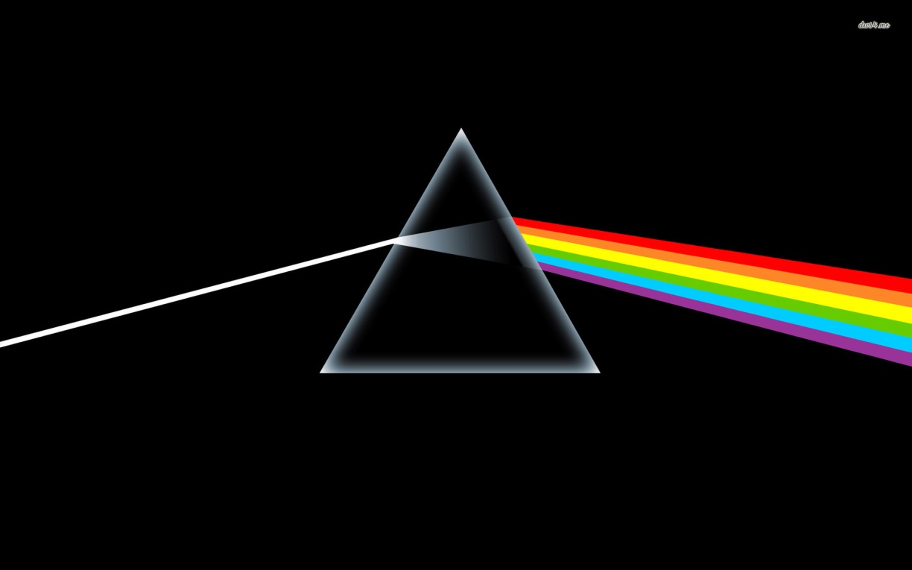
Table of Contents
Operators in C# and Operator Precedence
Arithmetic Operators
Logical Operators
Bitwise Operators
Comparison Operators
Assignment Operators
Other Operators
Implicit and Explicit Type Conversions
Expressions

Slide 3
What is an Operator?
Operator is an operation performed over data at runtime
Takes one or more arguments (operands)
Produces a new value
Example of operators:
Operators have precedence
Precedence defines which will be evaluated first
Expressions are sequences of operators and operands that are evaluated to a single value, e.g. (a + b) / 2
Operator "+"
a = b + c;
Operator "="

Slide 4

Operators in C#
Operators in C# :
Unary – take one operand
Binary – take two operands
Ternary (?:) – takes three operands
Except for the assignment operators, all binary operators are left-associative
The assignment operators and the conditional operator (?:) are right-associative

Slide 5


Operators in C#
Arithmetic, Logical, Comparison, Assignment, Etc.

Slide 6
Categories of Operators in C#
Category | Operators
Arithmetic | + - * / % ++ --
Logical | && || ^ !
Binary | & | ^ ~ << >>
Comparison | == != < > <= >=
Assignment | = += -= *= /= %= &= |= ^= <<= >>=
String concatenation | +
Type conversion | is as typeof
Other | . [] () ?: new

Slide 7

Operators Precedence

Slide 8
Operators Precedence
Precedence | Operators
Highest | ()
 | ++ -- (postfix) new typeof
 | ++ -- (prefix) + - (unary) ! ~
 | * / %
 | + -
 | << >>
 | < > <= >= is as
 | == !=
 | &
Lower | ^

Slide 9
Operators Precedence (2)
Precedence | Operators
Higher | |
 | &&
 | ||
 | ?:
Lowest | = *= /= %= += -= <<= >>= &= ^= |=
Parenthesis operator always has highest precedence
Note: prefer using parentheses, even when it seems stupid to do so

Slide 10
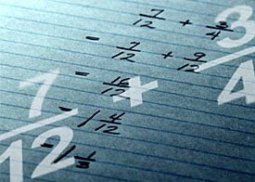
Arithmetic Operators

Slide 11
Arithmetic Operators
Arithmetic operators +, -, * are the same as in math
Division operator / if used on integers returns integer (without rounding) or exception
Division operator / if used on real numbers returns real number or Infinity or NaN
Remainder operator % returns the remainder from division of integers
The special addition operator ++ increments a variable

Slide 12
Arithmetic Operators – Examples
int squarePerimeter = 17;
double squareSide = squarePerimeter / 4.0;
double squareArea = squareSide * squareSide;
Console.WriteLine(squareSide); // 4.25
Console.WriteLine(squareArea); // 18.0625
int a = 5;
int b = 4;
Console.WriteLine( a + b ); // 9
Console.WriteLine( a + b++ ); // 9
Console.WriteLine( a + b ); // 10
Console.WriteLine( a + (++b) ); // 11
Console.WriteLine( a + b ); // 11

Slide 13
Arithmetic Operators – Example (2)
Console.WriteLine(12 / 3); // 4
Console.WriteLine(11 / 3); // 3
Console.WriteLine(11.0 / 3); // 3.666666667
Console.WriteLine(11 / 3.0); // 3.666666667
Console.WriteLine(11 % 3); // 2
Console.WriteLine(11 % -3); // 2
Console.WriteLine(-11 % 3); // -2
Console.WriteLine(1.5 / 0.0); // Infinity
Console.WriteLine(-1.5 / 0.0); // -Infinity
Console.WriteLine(0.0 / 0.0); // NaN
int x = 0;
Console.WriteLine(5 / x); // DivideByZeroException

Slide 14
Arithmetic Operators – Overflow Examples
int bigNum = 2000000000;
int bigSum = 2 * bigNum; // Integer overflow!
Console.WriteLine(bigSum); // -294967296
bigNum = Int32.MaxValue;
bigNum = bigNum + 1;
Console.WriteLine(bigNum); // -2147483648
checked
{
// This will cause OverflowException
bigSum = bigNum * 2;
}

Slide 15

Arithmetic Operators
Live Demo

Slide 16

Logical Operators

Slide 17
Logical Operators
Logical operators take boolean operands and return boolean result
Operator ! turns true to false and false to true
Behavior of the operators &&, || and ^ (1 == true, 0 == false):
Operator | || | || | || | || | && | && | && | && | ^ | ^ | ^ | ^
Operand1 | 0 | 0 | 1 | 1 | 0 | 0 | 1 | 1 | 0 | 0 | 1 | 1
Operand2 | 0 | 1 | 0 | 1 | 0 | 1 | 0 | 1 | 0 | 1 | 0 | 1
Result | 0 | 1 | 1 | 1 | 0 | 0 | 0 | 1 | 0 | 1 | 1 | 0

Slide 18
Logical Operators – Example
bool a = true;
bool b = false;
Console.WriteLine(a && b); // False
Console.WriteLine(a || b); // True
Console.WriteLine(a ^ b); // True
Console.WriteLine(!b); // True
Console.WriteLine(b || true); // True
Console.WriteLine(b && true); // False
Console.WriteLine(a || true); // True
Console.WriteLine(a && true); // True
Console.WriteLine(!a); // False
Console.WriteLine((5>7) ^ (a==b)); // False

Slide 19

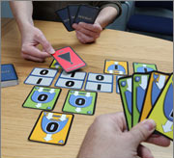
Logical Operators
Live Demo

Slide 20

Bitwise Operators

Slide 21
Bitwise Operators
Bitwise operator ~ turns all 0 to 1 and all 1 to 0
Like ! for boolean expressions but bit by bit
The operators |, & and ^ behave like ||, && and ^ for boolean expressions but bit by bit
The << and >> move the bits (left or right)
Behavior of the operators|, & and ^:
Operator | | | | | | | | | & | & | & | & | ^ | ^ | ^ | ^
Operand1 | 0 | 0 | 1 | 1 | 0 | 0 | 1 | 1 | 0 | 0 | 1 | 1
Operand2 | 0 | 1 | 0 | 1 | 0 | 1 | 0 | 1 | 0 | 1 | 0 | 1
Result | 0 | 1 | 1 | 1 | 0 | 0 | 0 | 1 | 0 | 1 | 1 | 0

Slide 22
Bitwise Operators (2)
Bitwise operators are used on integer numbers (byte, sbyte, int, uint, long, ulong)
Bitwise operators are applied bit by bit
Examples:
ushort a = 3; // 00000000 00000011
ushort b = 5; // 00000000 00000101
Console.WriteLine( a | b); // 00000000 00000111
Console.WriteLine( a & b); // 00000000 00000001
Console.WriteLine( a ^ b); // 00000000 00000110
Console.WriteLine(~a & b); // 00000000 00000100
Console.WriteLine( a << 1); // 00000000 00000110
Console.WriteLine( a >> 1); // 00000000 00000001

Slide 23

Bitwise Operators – Tips & Tricks
How to get the bit at position p from a number n?
How to set the bit at position p to 0?
int p = 5;
int n = 291; // 00000001 00100011
int nRightP = n >> p; // 00000000 00001001
int bit = nRightP & 1; // 00000000 00000001
Console.WriteLine(bit); // 1
int p = 5;
int n = 291; // 00000001 00100011
int mask = ~(1 << p); // 11111111 11011111
int result = n & mask; // 00000001 00000011
Console.WriteLine(result); // 259

Slide 24

Bitwise Operators – Tips & Tricks (2)
How to set the bit at position p to 1?
How to print a binary number to the console?
int p = 4;
int n = 291; // 00000001 00100011
int mask = 1 << p; // 00000000 00010000
int result = n | mask; // 00000001 00110011
Console.WriteLine(result); // 307
Console.WriteLine(
Convert.ToString(result, 2).PadLeft(16, '0'));
// 0000000000110011

Slide 25


Bitwise Operators
Live Demo

Slide 26

Comparison and Assignment Operators

Slide 27

Comparison Operators
Comparison operators are used to compare variables
==, <, >, >=, <=, !=
Comparison operators example:
int a = 5;
int b = 4;
Console.WriteLine(a >= b); // True
Console.WriteLine(a != b); // True
Console.WriteLine(a == b); // False
Console.WriteLine(a == a); // True
Console.WriteLine(a != ++b); // False
Console.WriteLine(a > b); // False

Slide 28

Assignment Operators
Assignment operators are used to assign a value to a variable ,
=, +=, -=, |=, ...
Assignment operators example:
int x = 6;
int y = 4;
Console.WriteLine(y *= 2); // 8
int z = y = 3; // y=3 and z=3
Console.WriteLine(z); // 3
Console.WriteLine(x |= 1); // 7
Console.WriteLine(x += 3); // 10
Console.WriteLine(x /= 2); // 5

Slide 29

Comparison and Assignment Operators
Live Demo

Slide 30

Other Operators

Slide 31

Other Operators
String concatenation operator + is used to concatenate strings
If the second operand is not a string, it is converted to string automatically
string first = "First";
string second = "Second";
Console.WriteLine(first + second); // FirstSecond
string output = "The number is : ";
int number = 5;
Console.WriteLine(output + number);
// The number is : 5

Slide 32
Other Operators (2)
Member access operator . is used to access object members
E.g. DateTime.Now.DayOfWeek.ToString()
Square brackets [] are used with arrays, indexers and attributes
E.g. numbers[3], "Hello"[2]
Parentheses ( ) are used to override the default operator precedence, e.g. (a + b) / 2
Class cast operator (type) is used to cast one compatible type to another, e.g. (uint) -1

Slide 33
Other Operators (3)
Conditional operator ?: has the form
(if b is true then the result is x else the result is y)
The new operator is used to create new objects
The typeof operator returns System.Type object (the reflection of a type), e.g. typeof(int)
The is operator checks if an object is compatible with given type, e.g. 5 is int → true; 3.14 is float → false
b ? x : y

Slide 34
Other Operators (4)
Null-coalescing operator ?? is used to define a default value for both nullable value types and reference types
It returns the left-hand operand if it is not null
Otherwise it returns the right-hand operand
Here the value of y is -1
int? x = null;
int y = x ?? -1;
int? x = 1;
int y = x ?? -1;
Here the value of y is 1

Slide 35
Other Operators – Example
int a = 6;
int b = 4;
Console.WriteLine(a > b ? "a>b" : "b>=a"); // a>b
Console.WriteLine((long) a); // 6
int c = b = 3; // b=3; followed by c=3;
Console.WriteLine(c); // 3
Console.WriteLine(a is int); // True
Console.WriteLine((a+b)/2); // 4
Console.WriteLine(typeof(int)); // System.Int32
int d = new int();
Console.WriteLine(d); // 0

Slide 36

Other Operators
Live Demo

Slide 37

Implicit and Explicit Type Conversions

Slide 38
Implicit Type Conversion
Implicit type conversion
Automatic conversion of value of one data type to value of another data type
Allowed when no loss of data is possible
"Larger" types can implicitly take values of smaller "types"
Example:
int i = 5;
long l = i; // implicit type conversion

Slide 39
Explicit Type Conversion
Explicit type conversion
Manual conversion of a value of one data type to a value of another data type
Allowed only explicitly by (type) operator
Required when there is a possibility of loss of data or precision
Example:
long l = 5;
int i = (int) l; // explicit type conversion

Slide 40
Type Conversions – Example
Example of implicit and explicit conversions:
Note: explicit conversion may be applied even when it is not required by the compiler
float heightInMeters = 1.74f; // Explicit conversion
double maxHeight = heightInMeters; // Implicit
double minHeight = (double) heightInMeters; // Explicit
float actualHeight = (float) maxHeight; // Explicit
float maxHeightFloat = maxHeight; // Compilation error!

Slide 41

Type Conversions
Live Demo

Slide 42
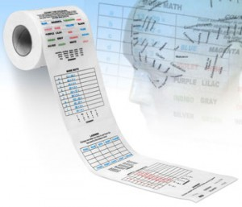
Expressions

Slide 43
Expressions
Expressions are sequences of operators, literals and variables that are evaluated to some value
Examples:
int r = (150 - 20) / 2 + 5; // r=70
// Expression for calculating a circle area
double surface = Math.PI * r * r;
// Expression for calculating a circle perimeter
double perimeter = 2 * Math.PI * r;

Slide 44
Expressions (2)
Expressions have:
Type (integer, real, boolean, ...)
Value
Examples:
Expression of type int. Calculated at compile time
Expression of type int. Calculated at runtime
int a = 2 + 3; // a = 5
int b = (a + 3) * (a - 4) + (2 * a + 7) / 4; // b = 12
bool greater = (a > b) || ((a == 0) && (b == 0));
Expression of type bool. Calculated at runtime

Slide 45
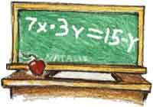
Expressions
Live Demo

Slide 46

Summary
We discussed the operators in C#:
Arithmetic, logical, bitwise, comparison, assignment and others
Operator precedence
Bitwise calculations (read / change a bit)
We learned when to use implicit and explicit type conversions
We learned how to use expressions

Slide 47









Operators and Expressions
https://softuni.bg/courses/programming-basics/

Slide 48
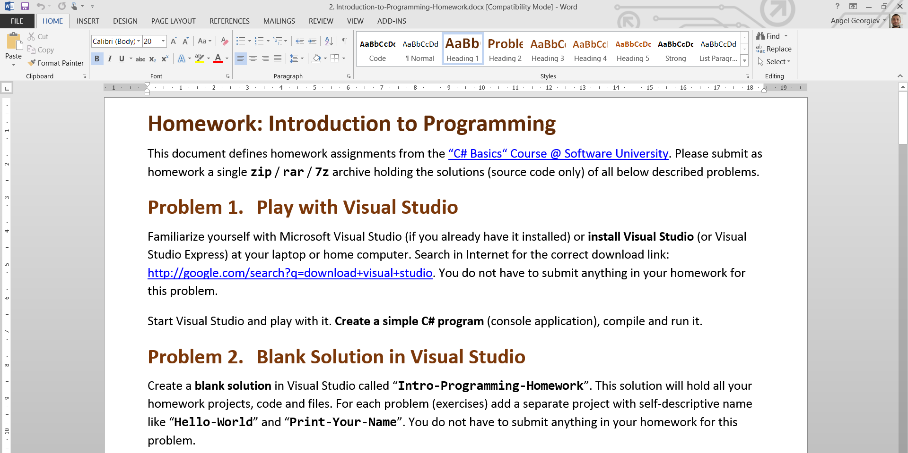
Homework Review
Live Demo

Slide 49
Resources
Boolean algebra (logic)
http://en.wikipedia.org/wiki/Boolean_algebra_%28logic%29
Bitwise mask
http://en.wikipedia.org/wiki/Mask_%28computing%29
Bitwise operation
http://en.wikipedia.org/wiki/Bitwise_operation
Bit hacks
graphics.stanford.edu/~seander/bithacks.html

Slide 50

License
This course (slides, examples, demos, videos, homework, etc.) is licensed under the "Creative Commons Attribution-NonCommercial-ShareAlike 4.0 International" license
Attribution: this work may contain portions from
"Fundamentals of Computer Programming with C#" book by Svetlin Nakov & Co. under CC-BY-SA license
"C# Part I" course by Telerik Academy under CC-BY-NC-SA license

Slide 51





Free Trainings @ Software University
Software University Foundation – softuni.org
Software University – High-Quality Education, Profession and Job for Software Developers
softuni.bg
Software University @ Facebook
facebook.com/SoftwareUniversity
Software University @ YouTube
youtube.com/SoftwareUniversity
Software University Forums – forum.softuni.bg

